Slide 1


Mentora
Smart Study Assisstant
Demo Presentation
22/12/2025

Slide 2
Mentora – Emotion-Aware Study Planning Assistant
The Gap
Planning apps organize tasks but do not adapt
AI study tools generate content but do not manage time
Emotional feedback is not systematically used in planning
The Problem
Students struggle to follow study plans under stress
Students lose motivation during intensive academic periods
Emotional state is rarely considered in study planning
Our Solution
Structured academic study planning
Emotional state used as supportive input
Transparent and controlled plan adaptation

Slide 3
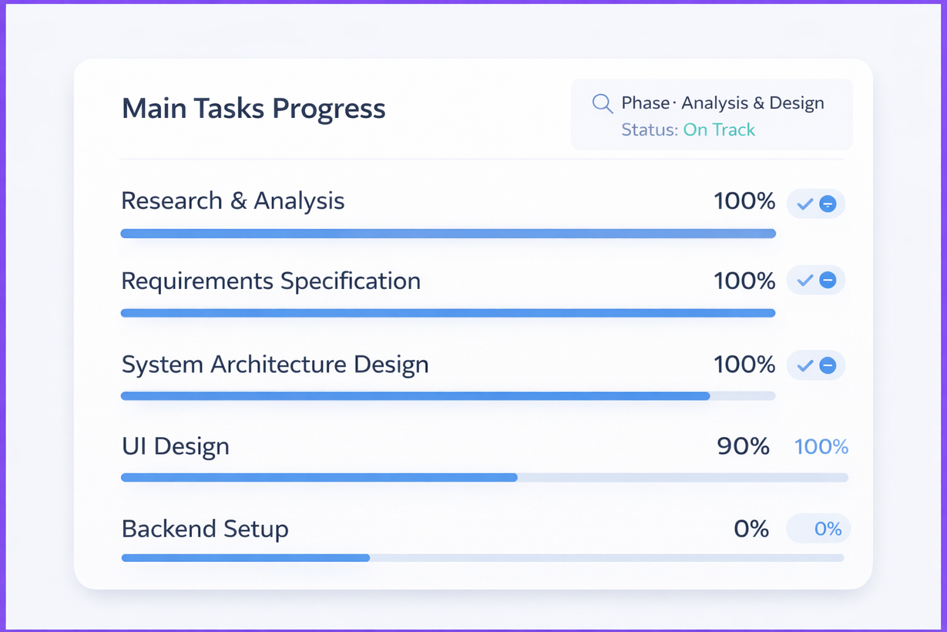
Current Status & Team Progress

Slide 4
Risks
Threats
Privacy & Data Protection
Personality & Emotion Detection Accuracy
Competitors
Opportunities
Personality & Emotion-Based Innovation
Supportive & Non-Diagnostic Positioning
High Engagement Strategy With Gamification

Slide 5
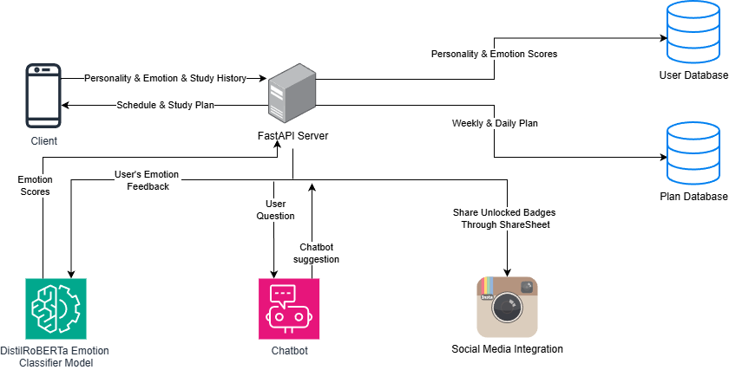
Architecture

Slide 6
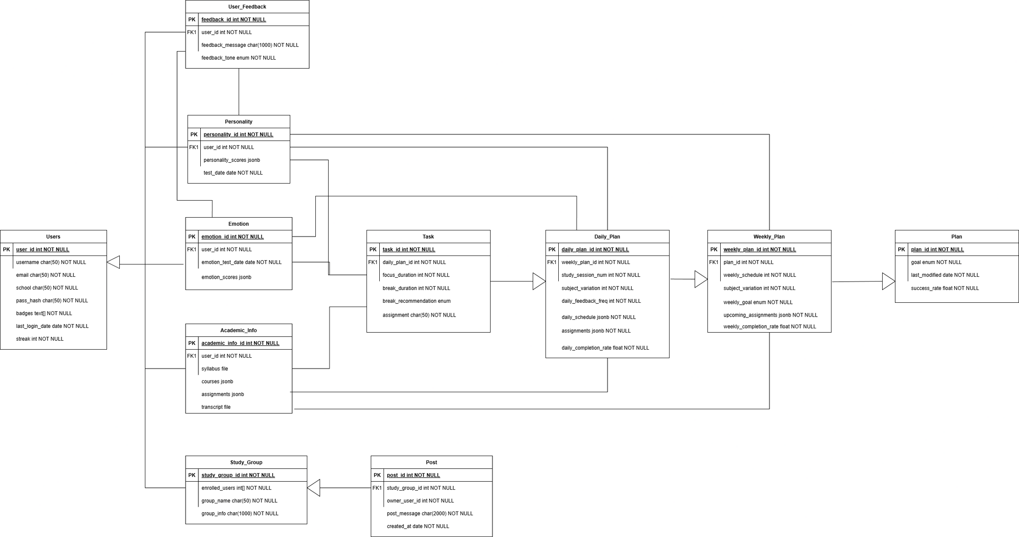
Database Schema

Slide 7

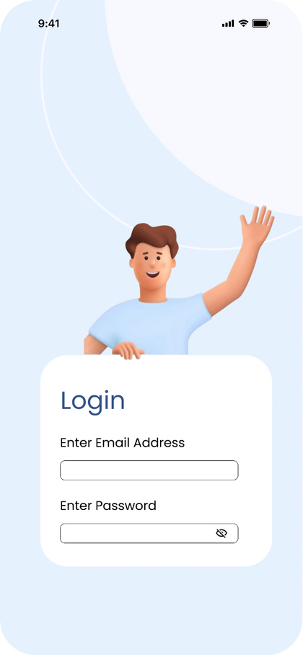
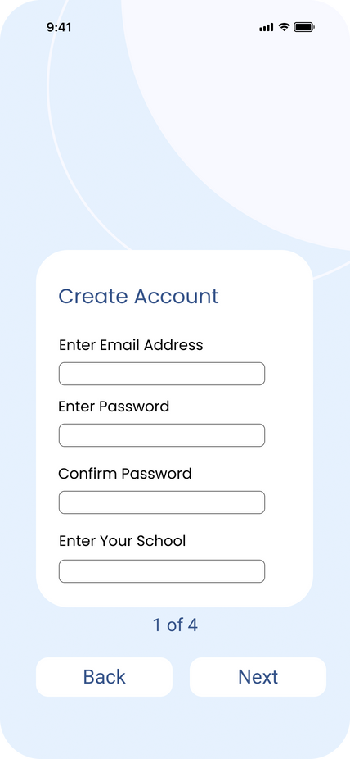
LOG IN / SIGN UP PAGE

Slide 8
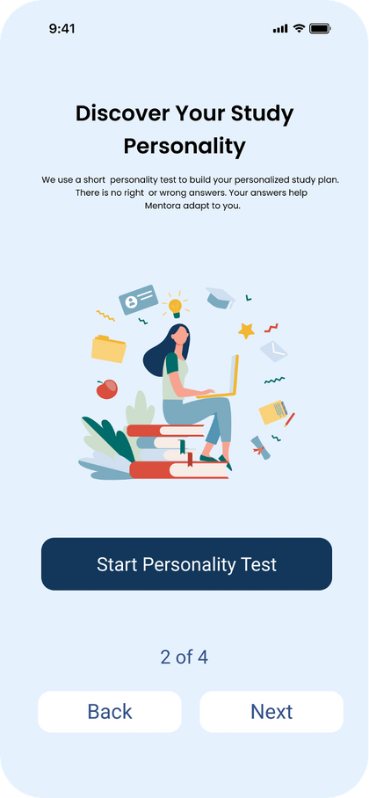
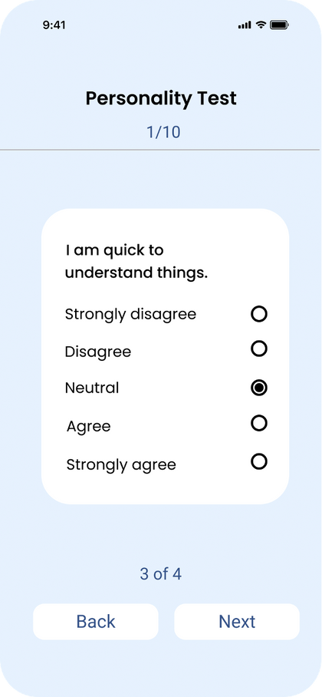
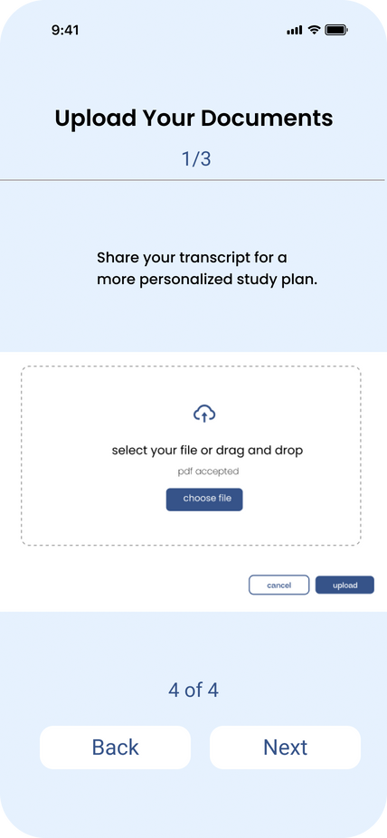
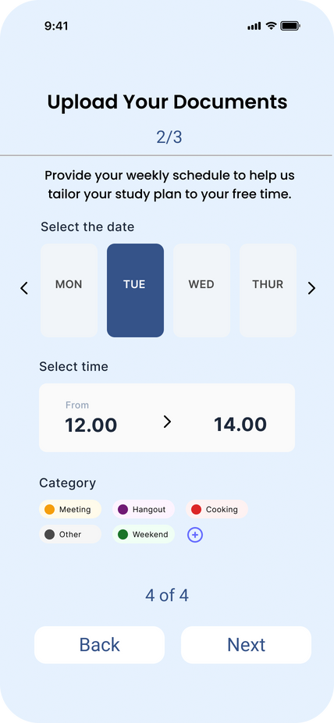
PERSONALITY TEST PAGE

Slide 9
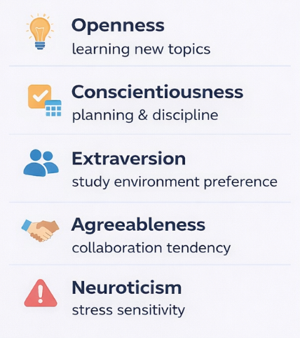
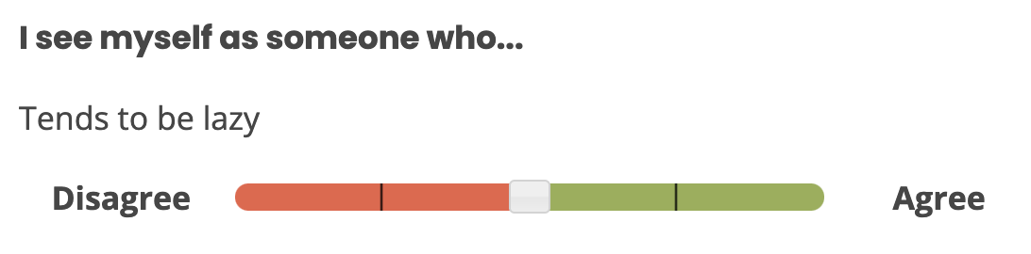
PERSONALITY TEST FRAMEWORK : OCEAN Model
https://www.truity.com/test/big-five-personality-test

Slide 10
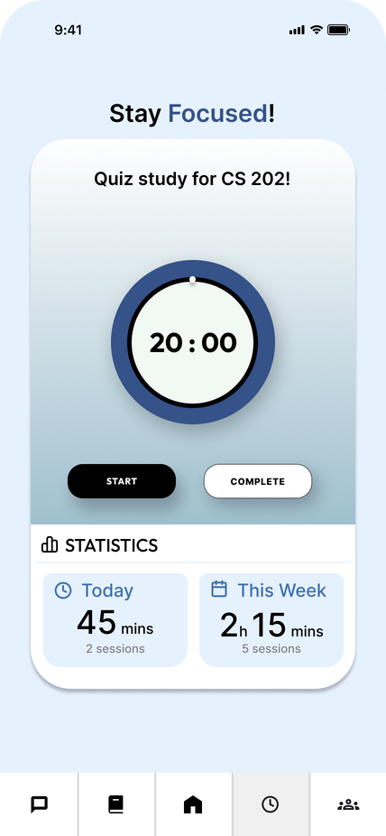
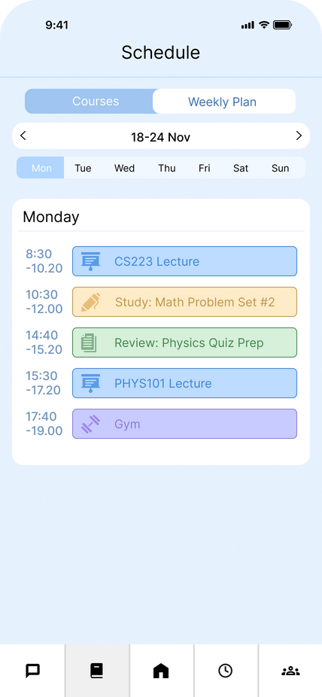
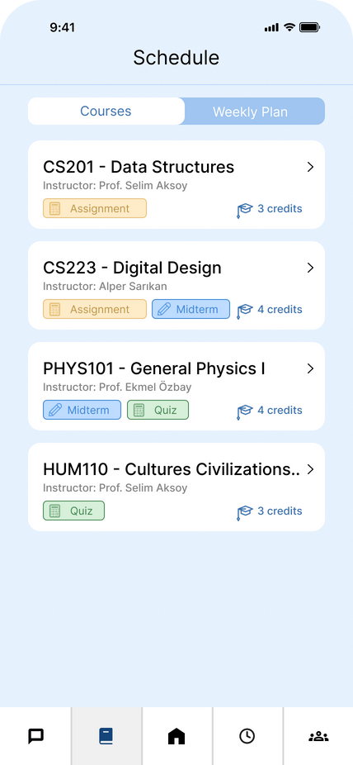
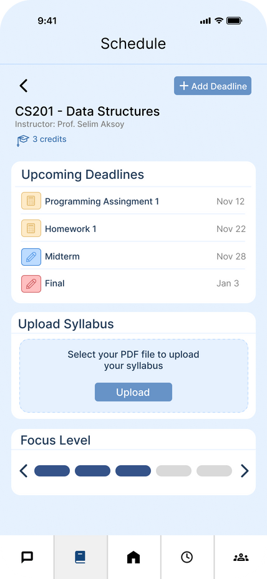
Study Pages Overview

Slide 11
Study Scheduling System
Study Schedule
Academic
Constraints
Personality
Parameters
Daily
Emotion Check

Slide 12
Academic Constraints
Upcoming Deadlines
Course credits and workload
Transkript
Focus Level
.

Slide 13
Personality Parameters
Openness
Conscientiousness
Extraversion
Agreeableness
Neuroticism

Slide 14
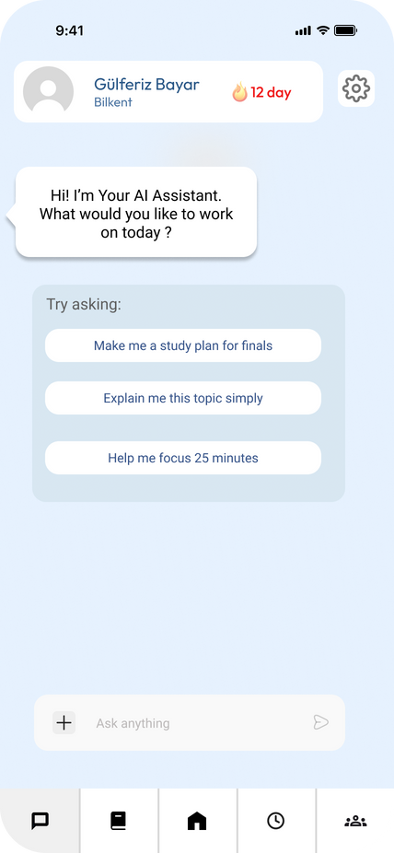
Daily Emotion Check
Joy
Sadness
Anger
Fear
Disgust
Neutral
Stressed

Slide 15
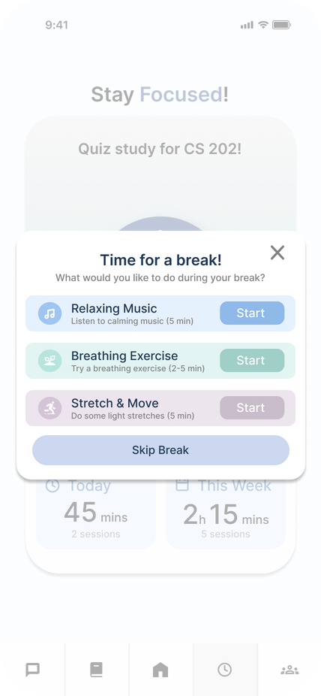
Pomodoro

Slide 16
AI Assistant
Updating the schedule through AI assistant with casual conversations.

Slide 17
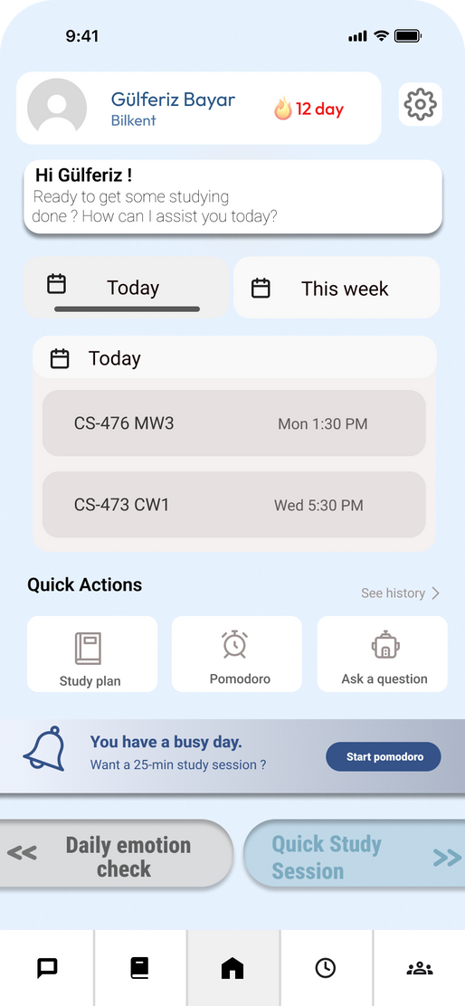
Main Page

Slide 18
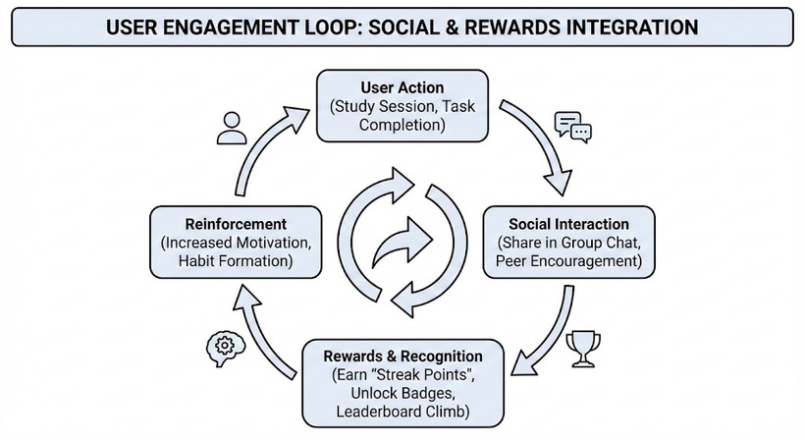
Strategic Approach: Gamification & Socialization
Engagement Strategy: Socialization & Gamification
Goal: Maximize User Retention and Session Duration.
Method: Transforming isolated study into a social ecosystem.
Core Concept: Triggering the "Habit Formation" loop.

Slide 19
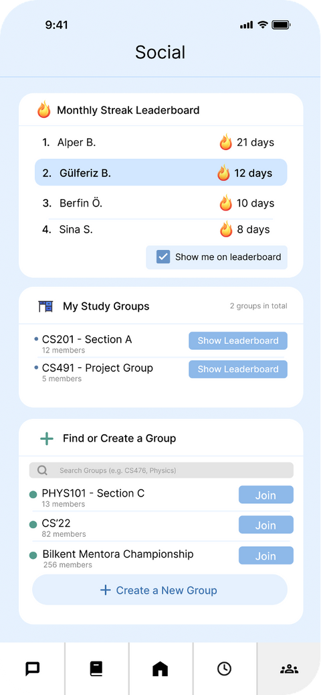
Peer-to-Peer Learning: Study Groups
Social Learning: Dynamic Study Groups
Goal: Dynamic matching based on courses or specific topics.
Method: "Study Buddy" system to prevent isolation.
Core Consept: Collective success through knowledge exchange.

Slide 20
Habit Loop: The Streak Mechanism
Habit Management: Streak Tracking
Increasing "Streak Score" for daily continuity.
Leveraging "Don't Break the Chain" psychology.
Visual feedback to encourage consistency.

Slide 21
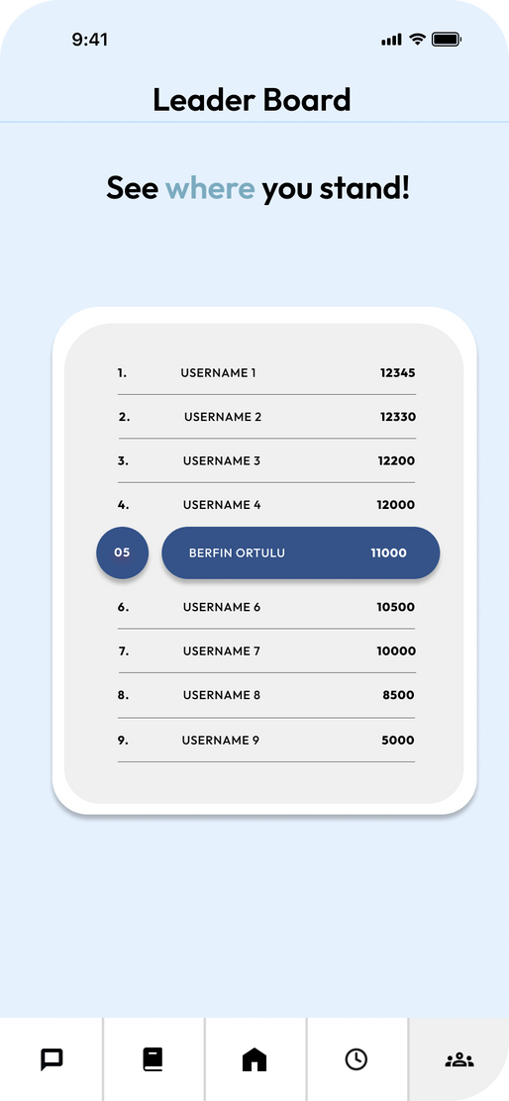
Competition & Motivation: Leaderboards
Leaderboards & Competitive Drive
Rankings based on Weekly Study Hours and Streaks.
Global vs. Friend Group classifications.
Social Proof: Motivating users to study more by seeing peers' progress.

Slide 22
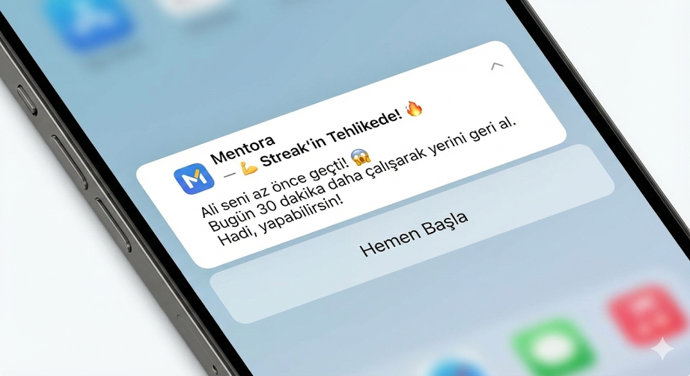
Smart Re-engagement: Notification System
Triggers: Smart Notification System
FOMO: "Your friend just passed your score!"
Loss Aversion: "Your streak is about to reset!"
Personalized Push Notification strategy to drive app launches.

Slide 23
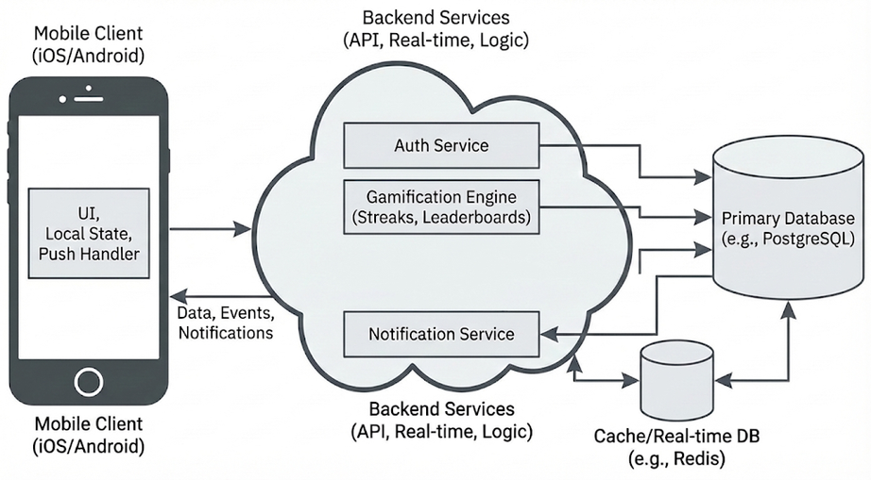
Technical Architecture
Infrastructure & Data Flow
FAST API based architecture.
Redis Sorted Sets for high-performance ranking algorithms.
Scalable notification microservices.

Slide 24
Thank you for listening

